Slide 1
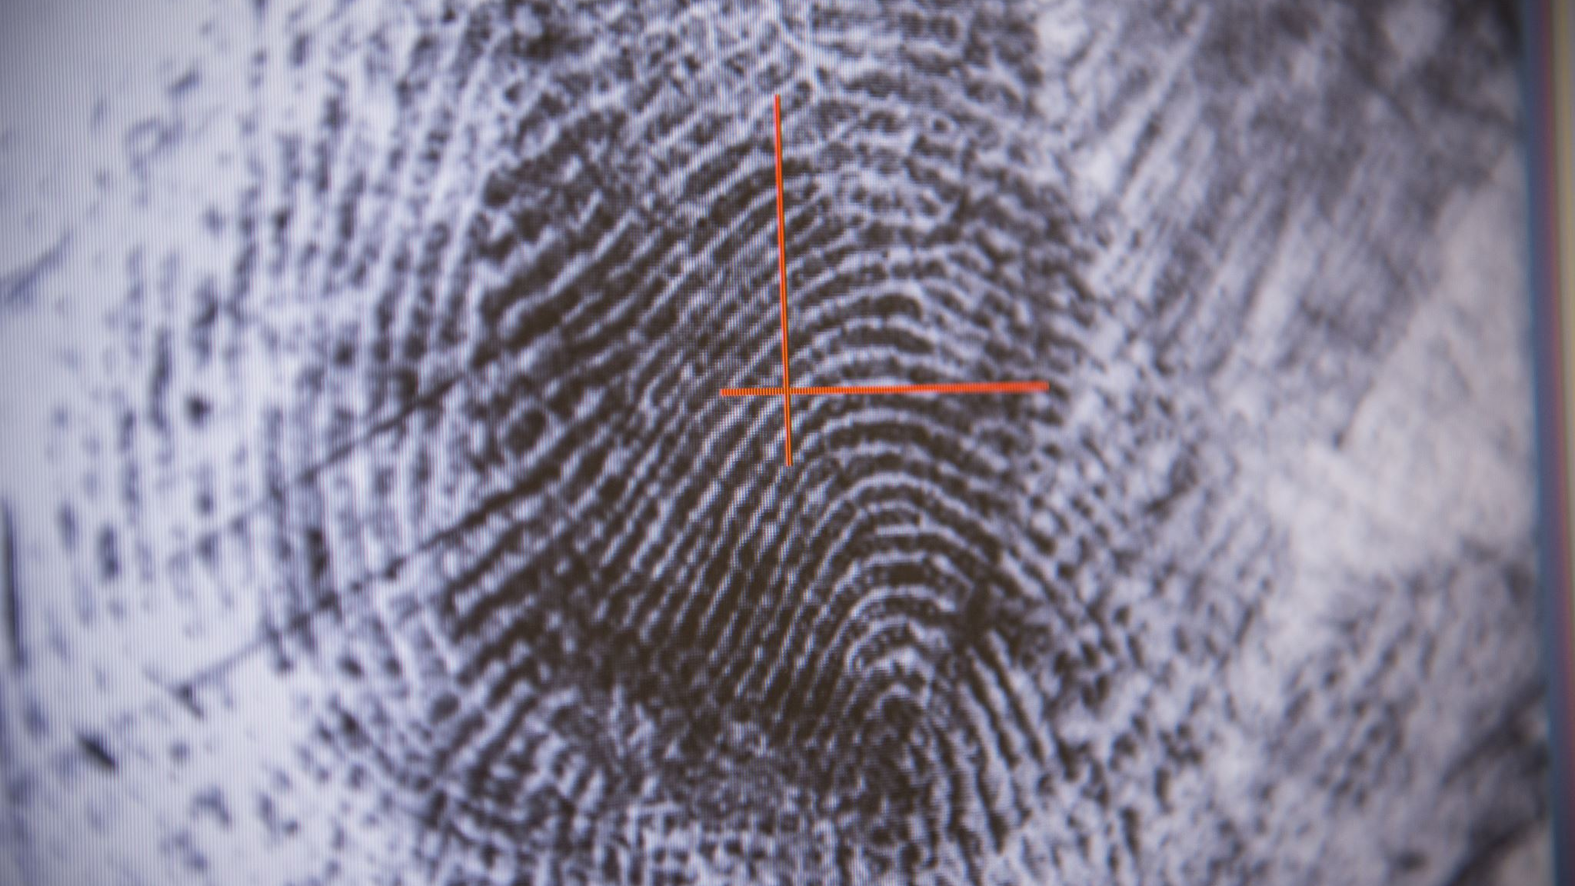
Sign Language Detection using Convolutional LSTM
Paul & Tejas

Slide 2
Agenda
Problem statement / Motivation
Data Collection and Preprocessing
Model Architecture
Training and Evaluation
Results
Challenges/ Limitations
Future Work

Slide 3
Motivation
With AI being the leading technology in solving multiple issues and making life easy, We wanted to use the AI technology to bridge communication barriers in the mute and deaf communities.
Sign language is a vital tool for communication in these communities and we wanted to build an AI model that will accurately identify the signs and interpret into text.

Slide 4
Data Collection and Preprocessing
Our primary sources of data are the American Sign Language Lexicon Video Dataset (ASLLVD) and the WLASL (World Level American Sign Language) Video Dataset available on Kaggle
As part of preprocessing, we converted .json files into csv that contains metadata like the name of each sign, Video id and other data.
Using this metadata as reference we mapped the video id to the actual videos in our videos folder.
In our data the maximum number of videos available for any given sign was not more than 17. For our model we chose the signs which had at least 14 videos for consistency in the dataset.
We created a frame extraction function which takes the video path,
{then it reads the video frame by frame
then it resizes the frame height and width
then normalizes the frames
stores the frames in a list}

Slide 5
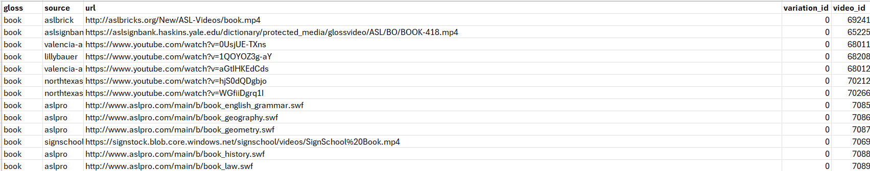
To use the frames and labels in the model, we converted the list of frames and labels into a num-py array and performed the one-hot encoding on the labels to convert categorical variables into binary vectors.
It is important to have the correct shape before using it in the model.

Slide 6
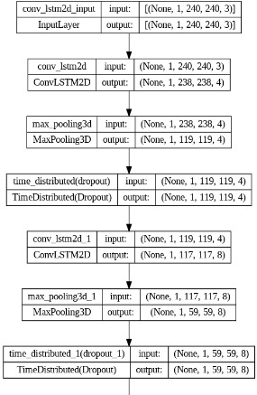
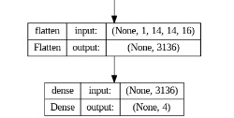
Model Architecture
Initial Model:
Initially we created a base model with ConvLSTM2D (Convolutional Long Short-Term Memory for 2 Dimensions). It combines the strengths of convolutional neural networks (CNNs) and LSTM networks to capture both spatial(pixels) and temporal(frame_order) dependencies in the data.
We used 3 combined layers of ConvLSTM2D, MaxPooling3D, and Time Distributed(Dropout(...)) layers and lastly Flatten layer which converts 3D into a 1D vector with features.
:::::::::::::::::::::::::::::::::
:::::::::::::::::::::::::::::::::
:::::::::::::::::::::::::::::::::
Fig 1. ConvLSTM Model
Notes:
Since video consist of a sequence of frames containing spatial information (pixels) and temporal information 3d (frame order). ConvLSTM networks are designed to capture spatial and temporal dependencies and are well-suited for analyzing videos.
We stacked multiple convlstm2d layers to learn the model from a video sequence.

Slide 7
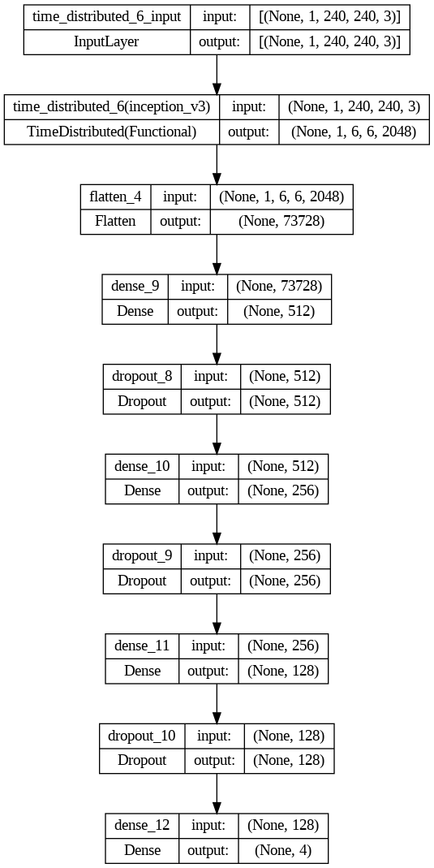
Model Optimization : Resnet50 and InceptionV3
We use Pre-trained model: Resnet-50 and Inceptionv3 and chosen the best model
by using pre-trained model.. it was overfitting so to reduce it we added dense and dropout layer for better performance and improve the overall performance.
Fig 2. InceptionV3 Model
Notes:
We used both model to check for prediction so we tried to optimize the both model and check for the accuracy of the model but inceptionv3 performs well.

Slide 8
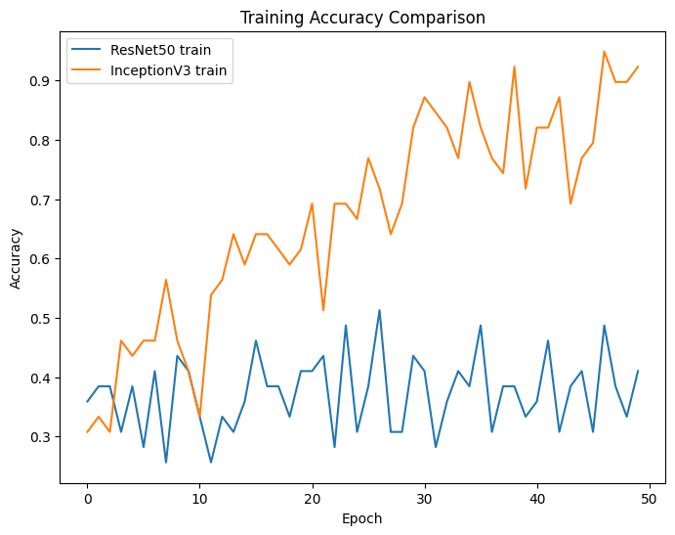
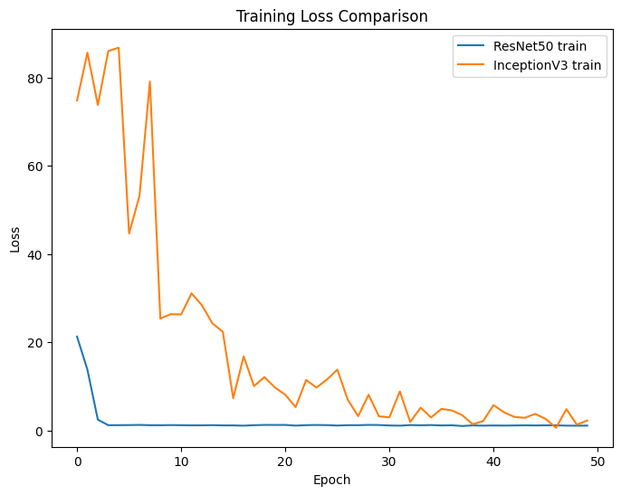
Comparison
ResNet-50, InceptionV3 touches the highest accuracy of 48% and 97%, respectively. Loss is constantly 0 for Resnet50 while there is gradual decrease in loss for Inceptionv3 which is around 0.05
InceptionV3 performs efficiently it looks like a better suited for your dataset.
Fig 3. Accuracy and Loss
Notes:
As there is fluctuation in 1st plot. Resnet50 gives result which might give incorrect result while in case of inceptionv3, the model might be overfitted but it gives correct predictions for most of the videos but major drawback is it gives incorrect predictions with high accuracy for some videos.
For 2nd plot. Resnet50 performs well with constant loss while inceptionv3 starts with high loss and gradually decreases to 0.

Slide 9
Training and Evaluation
We split the data into training and validation with 70-30 split.
We used the modified InceptionV3 as our final model. Trained the model for 50 epochs, with a batch size of 4 samples.
Shuffled data before each epoch to ensure that the model learns from the data in a random order.
Using early_stopping_callback to monitor the model's performance and stop training early if it does not improve after certain epochs.
Notes:
With the modification of the inceptionv3 model there is an increase in the overall performance of model. There is a significant loss and slight decrease in accuracy.

Slide 10
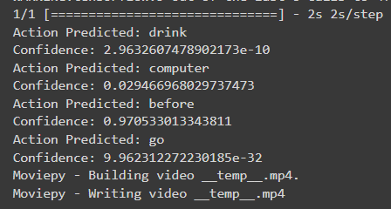
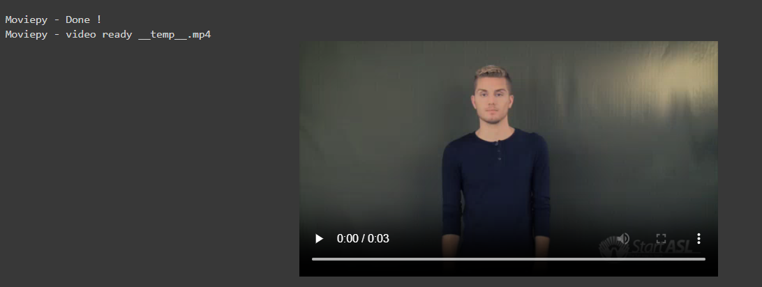
Results
We created a Predict function that takes video as input and sequence length (fixed number of frames that is passed to the model as a single sequence). This function process the frames and use the model to predict the probability of each class.
Fig 4. Prediction

Slide 11
Challenges
High loss due to limited and low-quality videos.
Limited data for words which have multiple different signs. Model can predict some signs, but it gets conflicted if similar action is performed for different sign.
Some video URL in dataset are not working, either they are removed or unavailable.
There are a limited number of online video datasets available for various sign language gestures.
Few classes are predicted wrongly so tried to optimize model and there was more than 30% improvement in the model.

Slide 12
Future Work
We want to manually develop a robust dataset with the help of deaf and mute communities, that has good number of videos for each class with high quality.
Work with Phd candidate to continue research and development in the same field.
Try another approach using YOLO V8
To make the identification using real-time camera via mobile application

Slide 13
Thank you

